Slide 1
Modern Frontend and JavaScript
Created by: Nazar Gorokhivskiy and Taras Chornyi, Frontend developers and 4th year IoT students

Slide 2
Agenda
Brief historical introduction to Javascript
Why is JS important?
Ratings, Jobs, Evolution Ubiquitous of Javascript (Atwood’s law)
Javascript basics
Javascript specifics

Slide 3
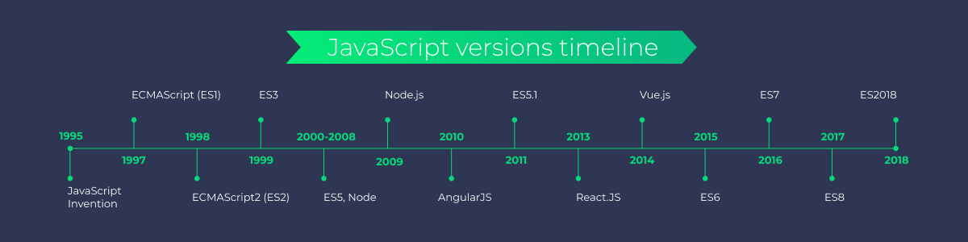
So how and when did it all happen?
https://www.youtube.com/watch?v=Sh6lK57Cuk4

Slide 4
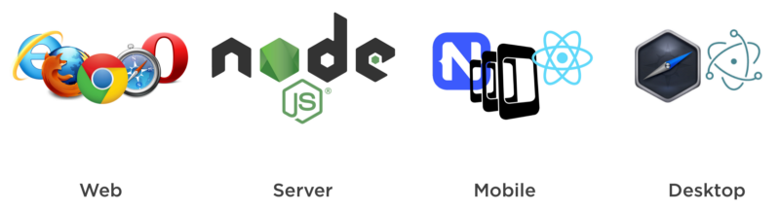
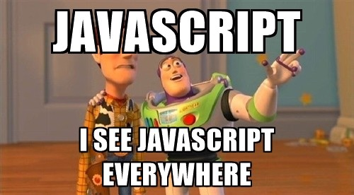
Javascript is everywhere...

Slide 5
And remember - Always bet on JavaScript! 🔥

Slide 6
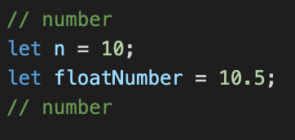
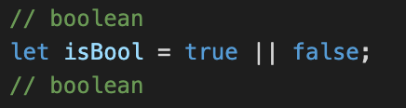
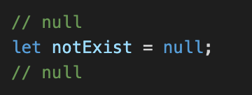
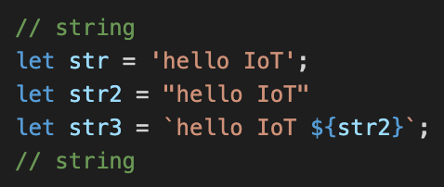
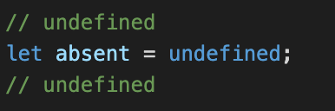
Types
https://learn.javascript.ru/types

Slide 7
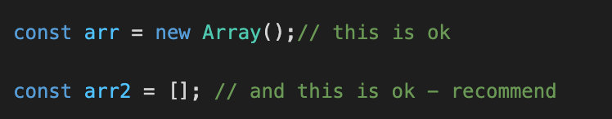
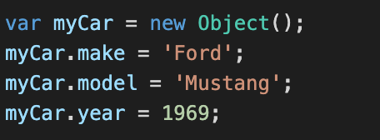
Object and Arrays
For objects and for Arrays

Slide 8
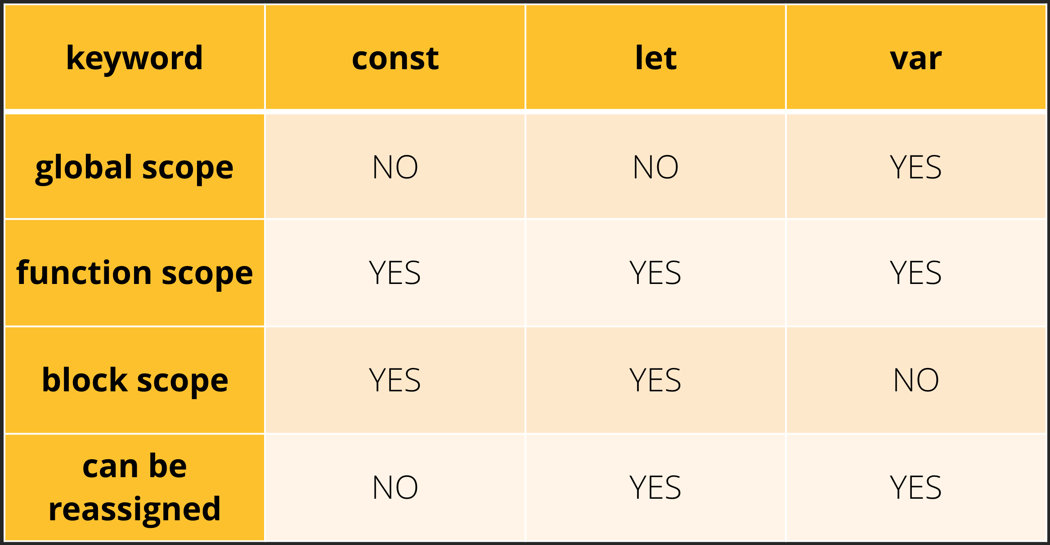
Let, const, var. What is the difference?
Link is here

Slide 9
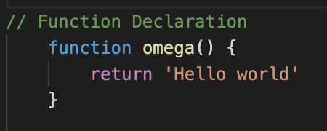
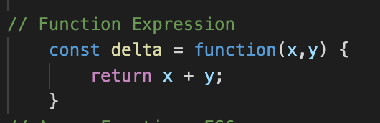
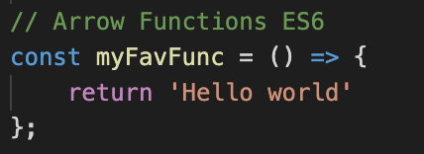
Function Declaration vs Function Expression
Difference between them is that Function Declaration is created by JS interpreter before code is executed, but Function Expression not.

Slide 10
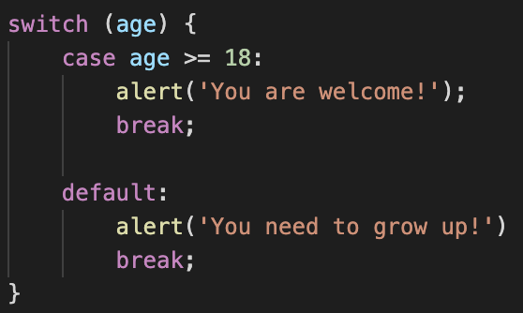
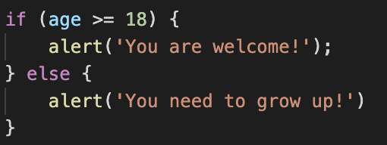
If/Else, switch/case, ternary operator

Slide 11
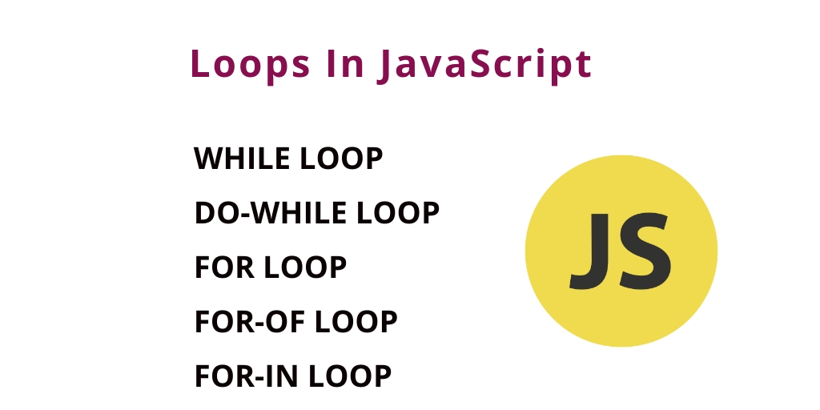
Loops in JS
https://learn.javascript.ru/while-for

Slide 12
First-class functions (functions as an objects)
All functions in JavaScript behave like objects
Which means that functions can….
Be stored in a variable
Be passed as arguments to functions
Be returned by functions
Be stored in some data structure
Hold their own properties and methods.
JavaScript Weekly: An Introduction to First-Class Functions

Slide 13
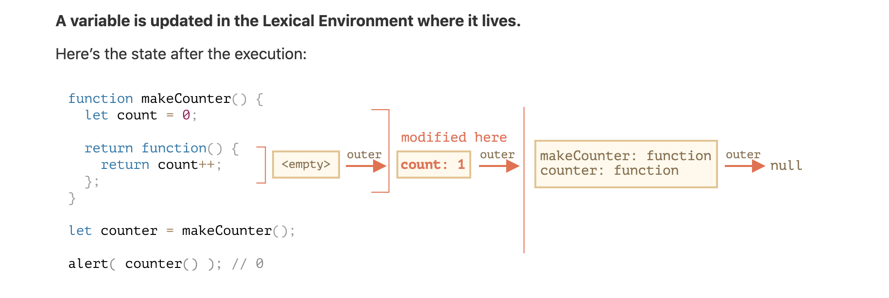
Scope, Closure
https://www.youtube.com/watch?v=3a0I8ICR1Vg

Slide 14
“This” keyword in Javascript
this - is a reference to a current execution context
and this is strange….
sooo, please, avoid it in most of the cases (exception is OOP approach)
here some code examples ->
https://habr.com/ru/post/149516/

Slide 15
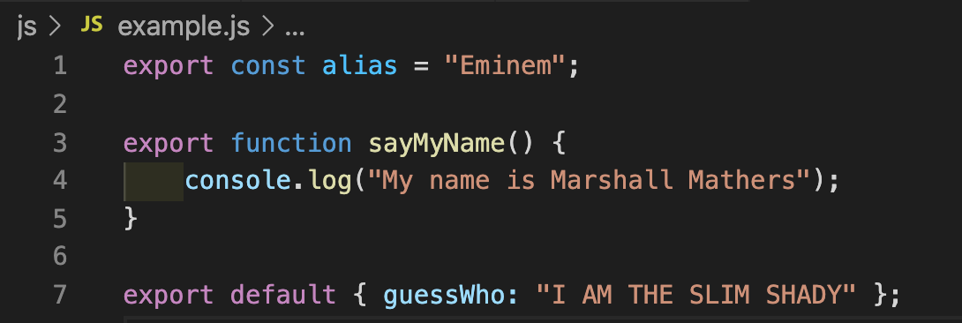
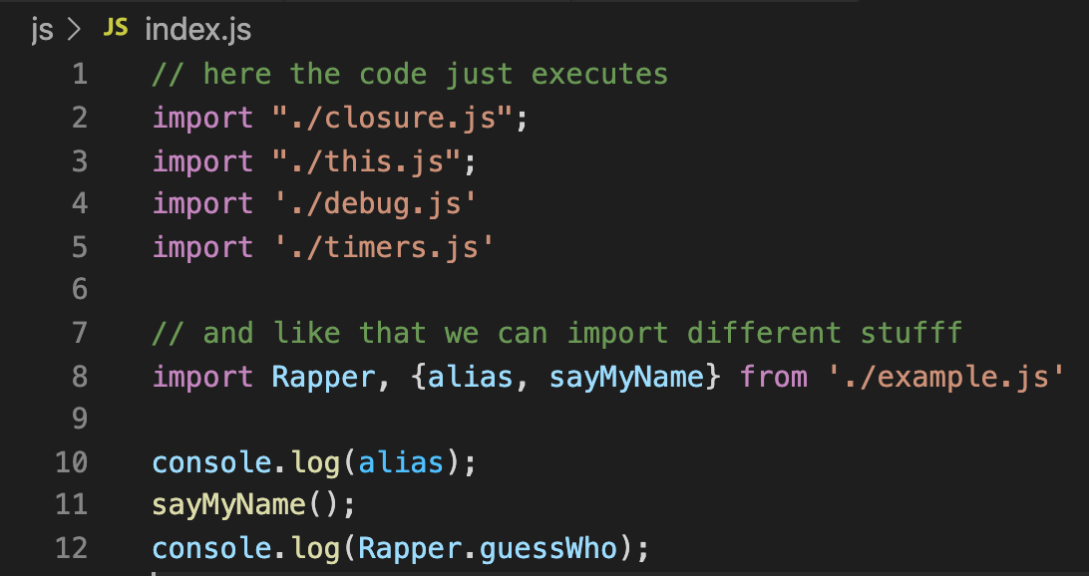
ES6 import/export
export - allows you to expose your code to external modules
import - allows you to take and use this code inside your modules
https://javascript.info/import-export

Slide 16
The end!
Always bet on JavaScript 😉

